Slide 1
Uva 11542
Square
Time: 2 seconds

Slide 2
Problem Descriptions
Given n integers you can generate 2^{n}-1n on-empty subsets from them.
Determine for how many of these subsets the product of all the integers in that is a perfect square.
For example for the set {4,6,10,15} there are 3 such subsets.
{4}, {6,10,15} and {4,6,10,15}.
A perfect square is an integer whose square root is an integer. For example 1, 4, 9, 16, . . . .

Slide 3
Input
Input contains multiple test cases.
First line of the input contains T (1 ≤ T ≤ 30) the number of test cases.
Each test case consists of 2 lines.
First line contains n (1 ≤ n ≤ 100)
Second line contains n space separated integers.
All these integers are between 1 and 1015.
None of these integers is divisible by a prime greater than 500.

Slide 4
Output
For each test case output is a single line containing one integer denoting the number of non-empty subsets whose integer product is a perfect square.
The input will be such that the result will always fit into signed 64 bit integer.

Slide 5

Sample I/O
Number of test cases
4
3
2 3 5
3
6 10 15
4
4 6 10 15
3
2 2 2
0
1
3
3
Number of integer
{6x10x15=30²}
{4=2²}, {6x10x15=30²},{4x6x10x15=60²}
{2x2=2²}, {2x2=2²},{2x2=2²}

Slide 6
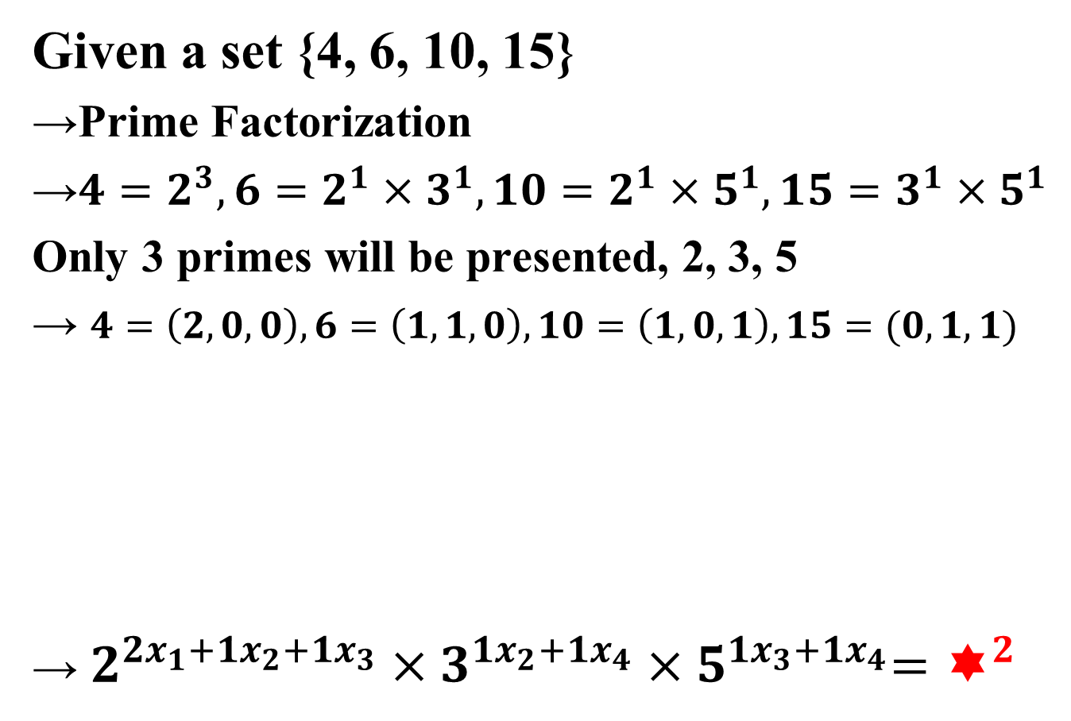
Analysis
Given a set {4, 6, 10, 15}
→Prime Factorization
→$4=2^{3}, 6=2^{1}×3^{1}, 10=2^{1}×5^{1}, 15=3^{1}×5^{1}$
Only 3 primes will be presented, 2, 3, 5
→ $4=\left(2, 0, 0\right), 6=\left(1,1,0\right), 10=\left(1, 0, 1\right), 15=(0,1,1)$
→ $2^{2x_{1}+1x_{2}+{1x}_{3}}×3^{1x_{2}+{1x}_{4}}{×5}^{1x_{3}+1x_{4}}=^{2}$
Select 4 or not : x₁ (1 or 0)
Select 6 or not : x₂ (1 or 0)
Select 10 or not : x₃ (1 or 0)
Select 15 or not : x₄ (1 or 0)

Slide 7








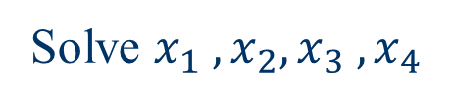

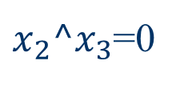

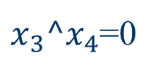

Analysis
→ $2^{2x_{1}+1x_{2}+{1x}_{3}}×3^{1x_{2}+{1x}_{4}}{×5}^{1x_{3}+1x_{4}}=^{2}$
$$\left\{\begin{matrix}x_{2}+x_{3}≡0 (mod 2) \\ x_{2}+x_{4}≡0 (mod 2) \\ x_{3}+x_{4}≡0 (mod 2)\end{matrix}\right.$$
$$\left\{\begin{matrix}x_{2} ^ x_{3} \\ x_{2}^{} ^ x_{4} \\ x_{3} ^{ x}_{4}\end{matrix}\right.$$
=1
=1
=1
Solve $x_{1} ,x_{2}, x_{3} , x_{4}$
Free variables: $x_{1} and x_{4}$
$$x_{1}$$
$$x_{3}$$
$$x_{4}$$
$$x_{2}$$
2
3
5
$$\left[\begin{matrix}0 1 1 0 0 \\ 0 1 0 1 0 \\ 0 0 1 1 0\end{matrix}\right]$$
$$\left[\begin{matrix}0 1 1 0 0 \\ 0 0 1 1 0 \\ 0 0 1 1 0\end{matrix}\right]$$
$$\left[\begin{matrix}0 1 1 0 0 \\ 0 0 1 1 0 \\ 0 0 0 0 0\end{matrix}\right]$$
$x_{2}^x_{3}$=0
$x_{3}^x_{4}$=0

Slide 8


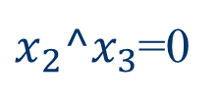
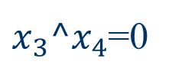


Analysis
→ $2^{2x_{1}+1x_{2}+{1x}_{3}}×3^{1x_{2}+{1x}_{4}}{×5}^{1x_{3}+1x_{4}}=^{2}$
$$\left[\begin{matrix}0 1 1 0 0 \\ 0 1 0 1 0 \\ 0 0 1 1 0\end{matrix}\right]$$
$$\left[\begin{matrix}0 1 1 0 0 \\ 0 0 1 1 0 \\ 0 0 1 1 0\end{matrix}\right]$$
$$\left[\begin{matrix}0 1 1 0 0 \\ 0 0 1 1 0 \\ 0 0 0 0 0\end{matrix}\right]$$
$x_{2}^x_{3}$=0
$x_{3}^x_{4}$=0
Free variables: $x_{1} and x_{4}$
$$∴2×2−1=3$$
$≡$ rank of a Matrix
$$≡number of non−zero row$$

Slide 9
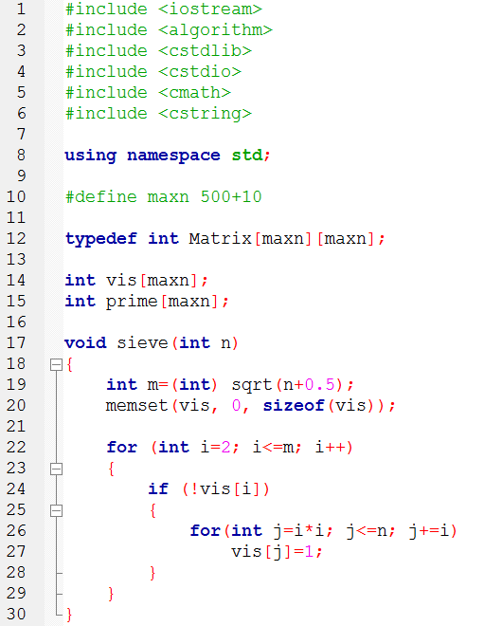
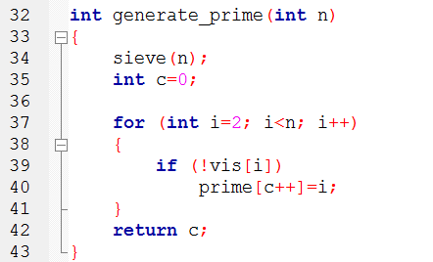
Sample Program
避免浮點數誤差

Slide 10
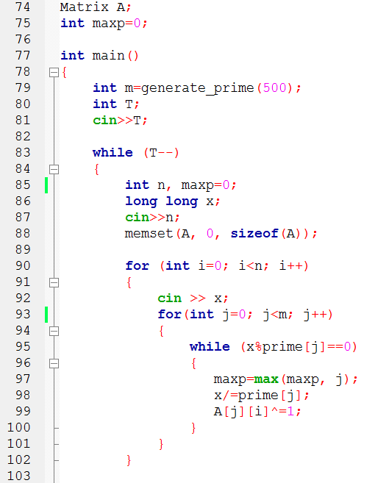
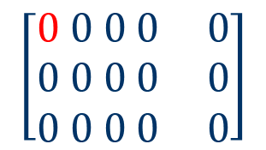
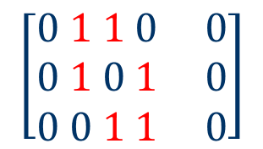
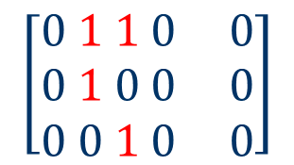
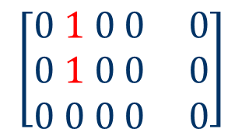
i=0
j=0
$$\left[\begin{matrix}0 0 0 0 0 \\ 0 0 0 0 0 \\ 0 0 0 0 0\end{matrix}\right]$$
i=1
j=0
$$\left[\begin{matrix}0 1 0 0 0 \\ 0 1 0 0 0 \\ 0 0 0 0 0\end{matrix}\right]$$
i=2
j=0
$$\left[\begin{matrix}0 1 1 0 0 \\ 0 1 0 0 0 \\ 0 0 1 0 0\end{matrix}\right]$$
i=3
j=0
$$\left[\begin{matrix}0 1 1 0 0 \\ 0 1 0 1 0 \\ 0 0 1 1 0\end{matrix}\right]$$
maxp=2

Slide 11
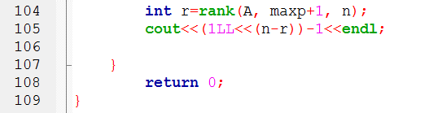
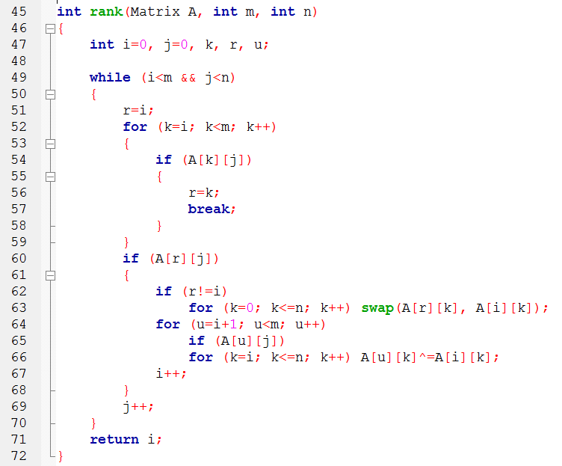

n
j=1
r
i=0
$$\left[\begin{matrix}0 1 1 0 0 \\ 0 1 0 1 0 \\ 0 0 1 1 0\end{matrix}\right]$$
m

